Slide 1



MAKERWOMEN CHALLENGE
In association with

Slide 2

Empower every women of all the age group to identify community problems and create tech and engineering solutions that develop their leadership, creative problem-solving skills and sustainability financially.

Slide 3
OUR MISSION
Enable technology accessible to every women of all age group by organising Events, Programs and Challenges

Slide 4
OUR VISION
Make every women capable to solve their local community problem with technology

Slide 5


100+
600+
250+
ABOUT GEEKSUP & METOOMENTOR
Events conducted across India
Apps/Websites developed through this events
Job Opportunities converted
Notes:
Idea: You can also create local versions of these with local numbers when talking about your program specifically.

Slide 6
ABOUT THE
CHALLENGE

Slide 7

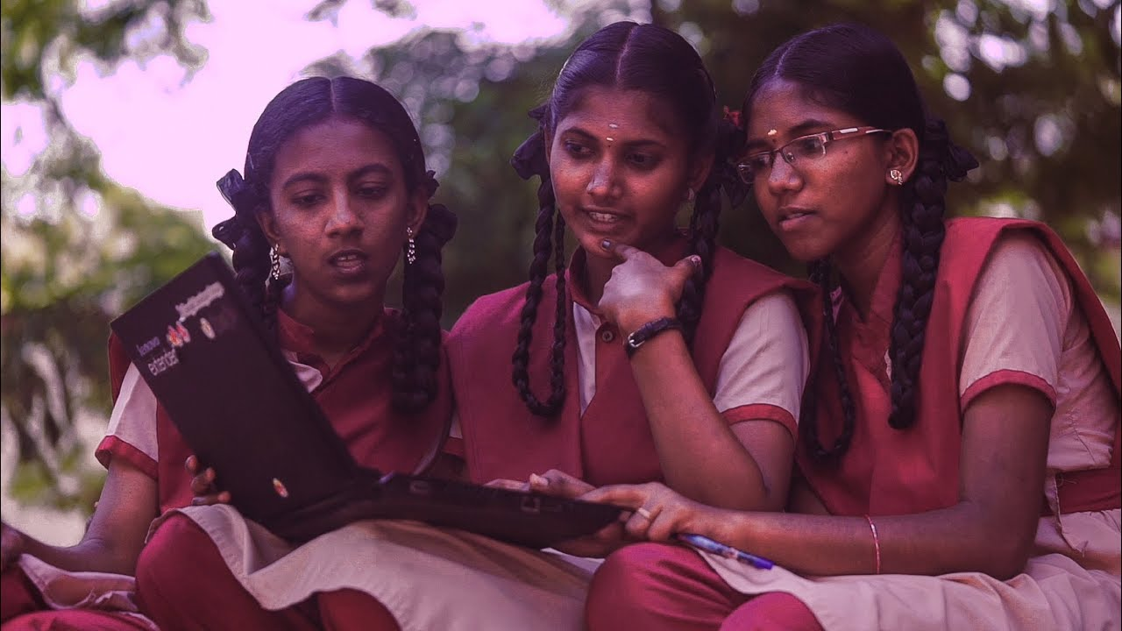
MAKERWOMEN CHALLENGE for JUNIORS
This is for School Girls who will solve problems using technology. Working in teams, girls find a problem in their community and build a prototype using DESIGN THINKING process. Along the way they develop their collaboration, problem solving, and leadership skills.

Slide 8
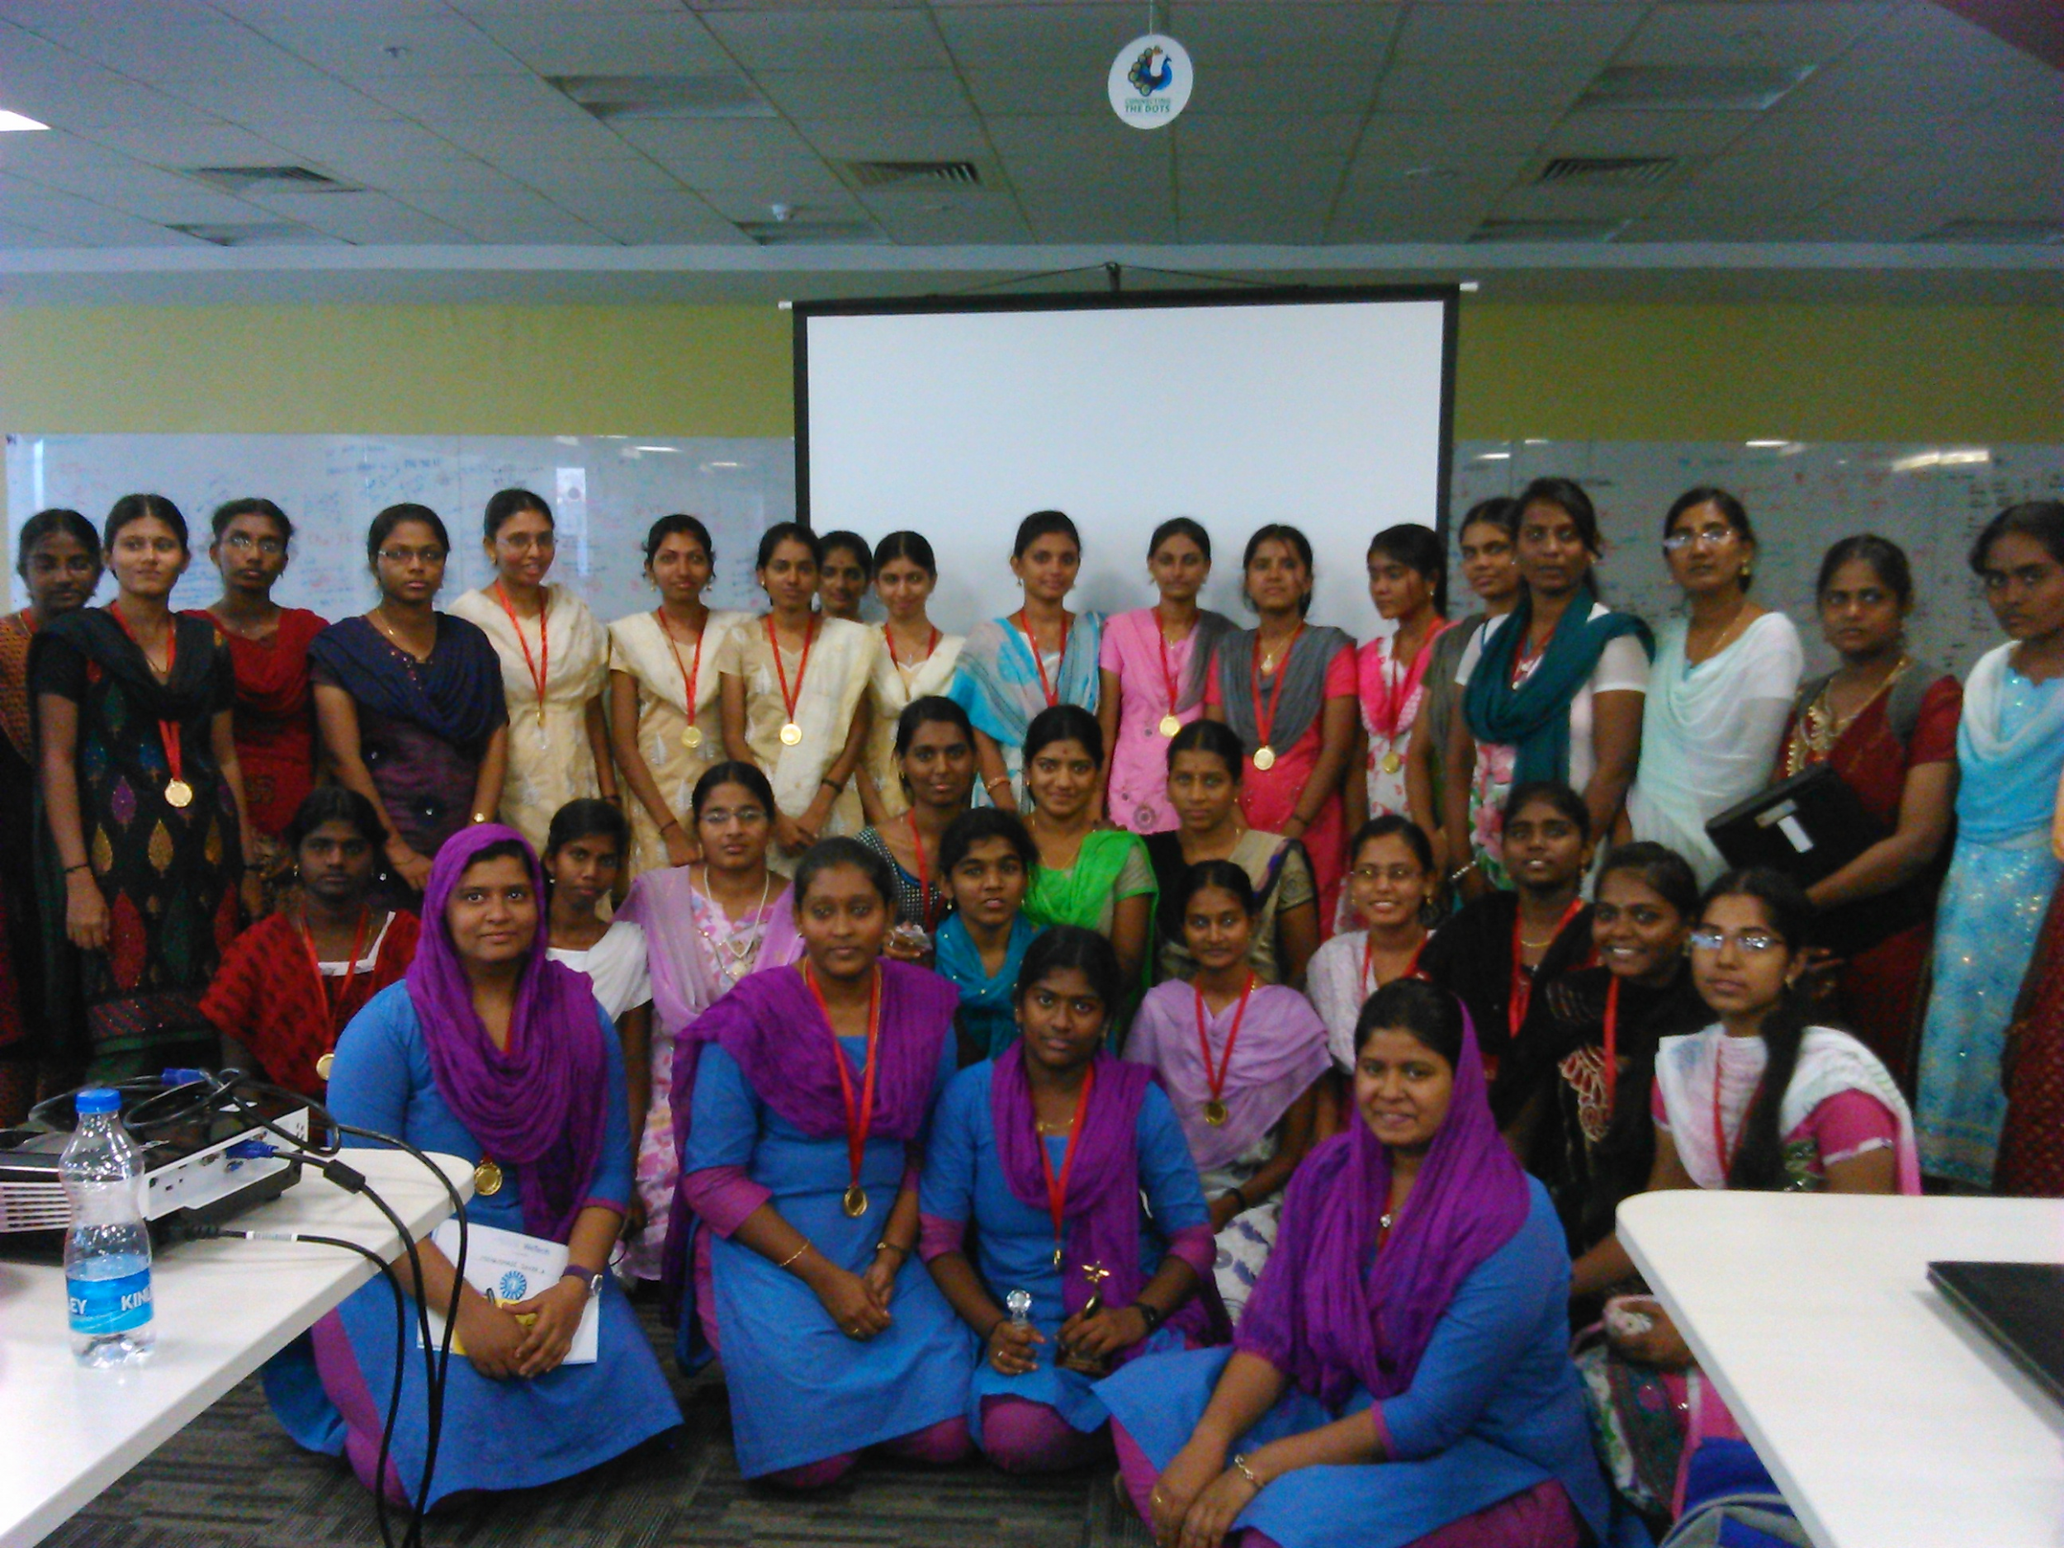
MAKERWOMEN CHALLENGE for SENIORS
This is for College Girls who will build a mobile app to solve the problem picked up by Juniors. Before to that, they learn BUILDING WEBSITE, Converting them into PWA and FRONT END/BACK END PROGRAMMING LANGUAGE of their choice.

Slide 9

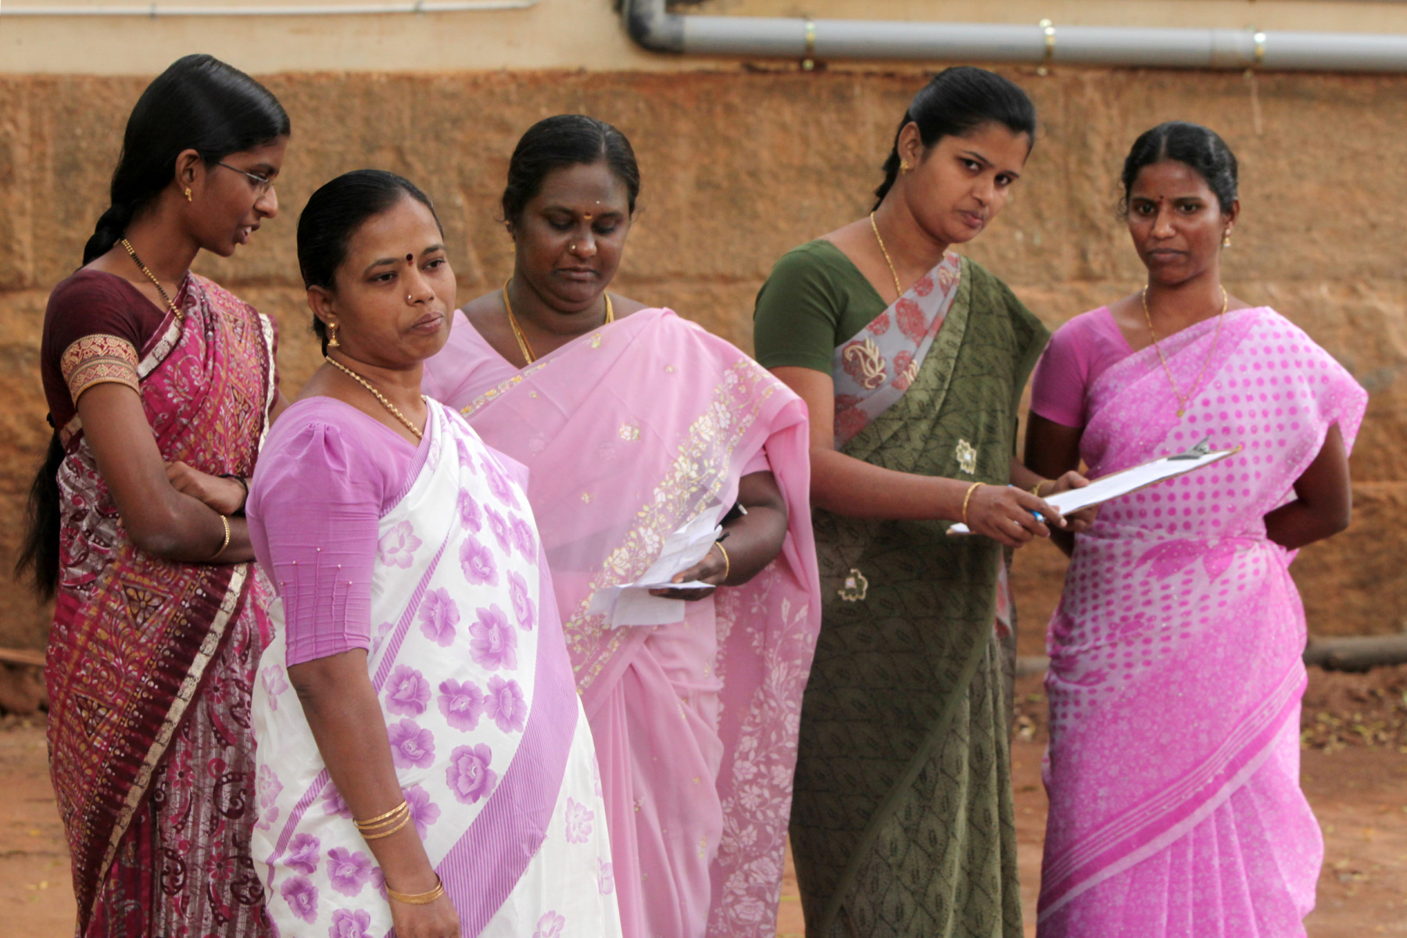
MAKERWOMEN CHALLENGE for WORKING LADIES
This is for Working Professionals who will do Marketing the product/idea created by Juniors and the app developed by Seniors. They will be trained on LOGO CREATION, DIGITAL MARKETING and MAKING QUALITY PITCH/DEMO VIDEO

Slide 10
Bringing three different age group women together for a common purpose that is to solve their local community problem with Technology

Slide 11
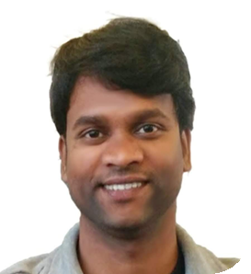
The Journey of empowering women started on 2014 by metoomentor.org as an NGO
Mr.M.Senthilkumar runs Metoomentor.org, GeeksUp
Mentored more than 2000 girls in Madurai
So far, 100+ apps created by our Madurai Girls and 3 apps using by TN Police department successfully
M. Senthilkumar
Founder of GeeksUp & Metoomentor.org

Slide 12
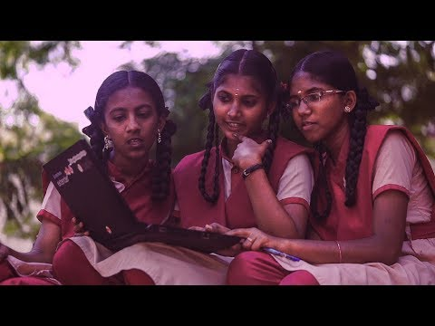
Connect To Global Level Competition - Technovation Girls

Slide 13
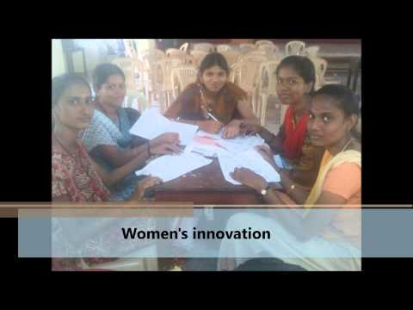
Connect to various Challenges/Hackathons, Events, Job Fairs across India
Notes:
Technovation Families Coimbatore

Slide 14
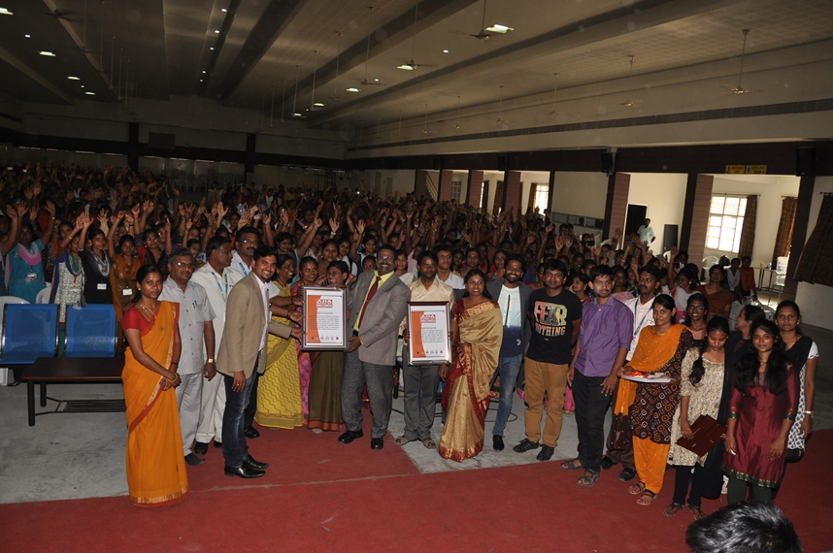
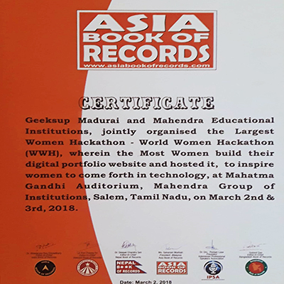
World Women Hackathon 2018
First time ever 2 DAYS + 2000 WOMEN built their Personal digital portfolio and hosted on Cloud. The record placed in ASIA BOOK OF RECORDS
Notes:
Technovation Families Coimbatore

Slide 15
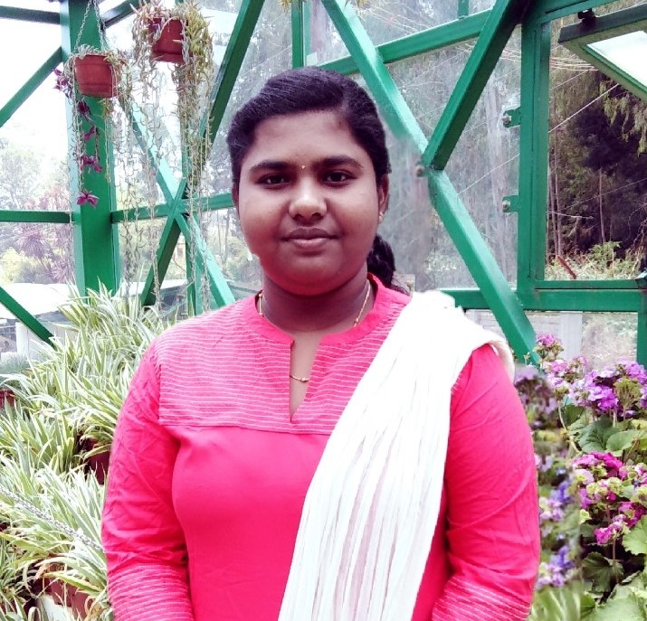
“I participated for a Program which aims to solve our local community problems using mobile application. The experience and participation in the program nourishes and nurtures my mind to build the future!”
Celsia (12th Grade)

Slide 16
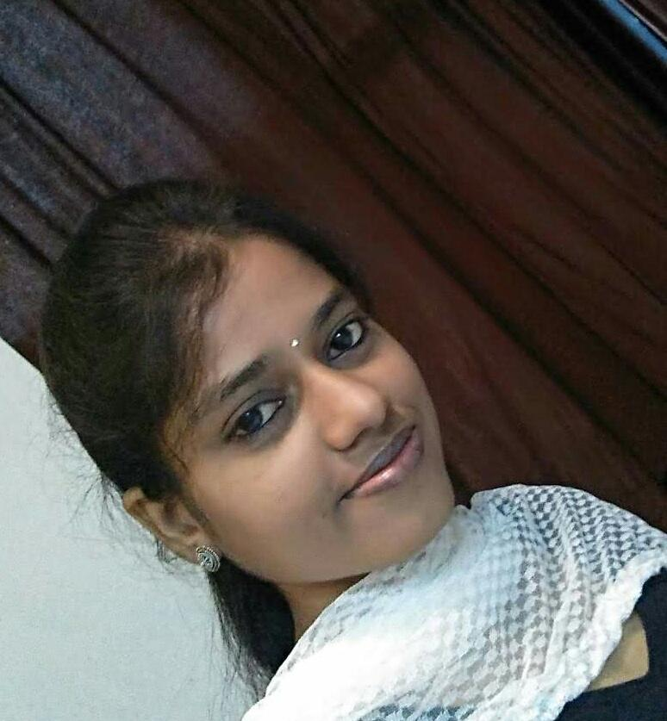
“I got to participate for a Program through metoomentor.org during my college. It was an amazing Journey. I learnt so many tech stuffs which helped me to get Job in Two MNC Companies before I complete my graduation!”
R.R. Priya(Cognizant Technology Solutions)

Slide 17
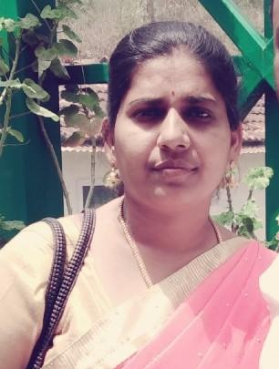
This Program will be very useful, if Woman/Homemaker learn this. They could learn new things. It will be beneficial for a Home maker because they can do this by sitting in their home. It is a great initiative which will help woman gather more knowledge from this current technology!
Mrs. Sudha (Homemaker )

Slide 18



THANK YOU!
Follow and tag our social media!
@makerwomen2020
@makerwomen2020
@makerwomen2020
If you have any queries, write to us at:
makerswomen2020@gmail.com

